Slide 1
Mapping and Analyzing Tropical Cyclone-Induced Damages through Landsat Satellite Imagery: Case Study of Cyclone Amphan in Bangladesh
Prepared By: Ummya Ayman Satil
Department: Geology and Mining
Prepared For: Dr. Tania Islam,
Assistant Professor,
University of Barishal

Slide 2
Introduction
Objective: Assess and quantify the damages caused by Cyclone Amphan using
Landsat satellite imagery.
Focus Areas: Water bodies, vegetation, and agricultural land.

Slide 3
Expected Outcomes
Detailed Damage Map: Comprehensive mapping of land cover changes.
Vegetation Loss Analysis: NDVI analysis to quantify vegetation health reduction.
Disaster Management Recommendations: Identify vulnerable areas for policymakers.
Future Disaster Applications: Model for assessing damages in future events.

Slide 4
Methodology
Data Collection:
Satellite images from USGS and NASA.
Field data for accuracy assessment.
Data Processing:
Preprocessing of satellite images (Months 1-2).
Unsupervised classification and NDVI analysis (Months 3-4).
Change detection and damage mapping (Month 5).

Slide 5
Resources Required
Software: GIS and remote sensing software (ArcGIS, ENVI).
Computing Resources: For image processing and data analysis.
Satellite Imagery Access: USGS and NASA databases.

Slide 6
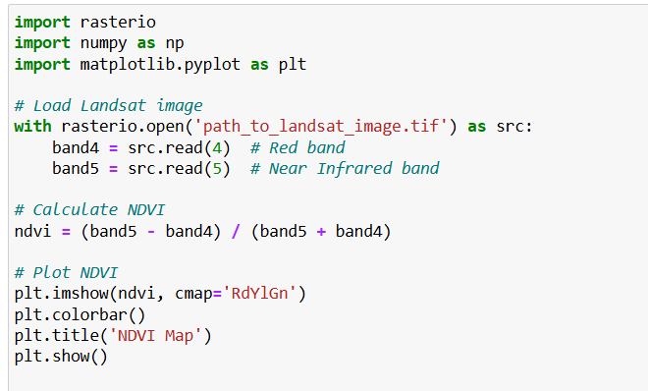
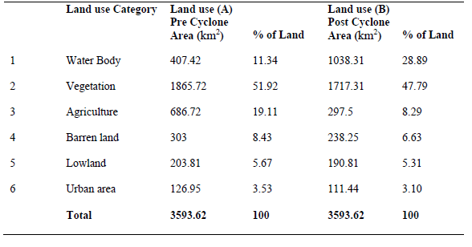
Python Code Example for NDVI Calculation

Slide 7
Conclusion
The project aims to provide a detailed analysis of cyclone-induced damages.
Utilization of satellite imagery will enhance disaster risk management strategies.

Slide 8
Questions & Discussion

